Slide 1
Culture Club
How your culture affects your success
More info on how to use this template at www.slidescarnival.com/help-use-presentation-template
This template is free to use under Creative Commons Attribution license

Slide 2
Our Agenda
Who
WAT!
Why & How

Slide 3

Hello!
CRob, n, adj, and v
Pronunciation: U.S. (K-robe)
CISSP, CSSLP, ITILv3, TOGAF9
Over 20 years of Enterprise-class Architecture, Engineering, Operations, and Security experience
Ambassador of Red Hat Product Security
Participant in the FIRST PSIRT SIG, VulnCoord SIG, and others
Co-Author FIRST PSIRT Services Framework
Pirate-enthusiast & hat-owner

Slide 4
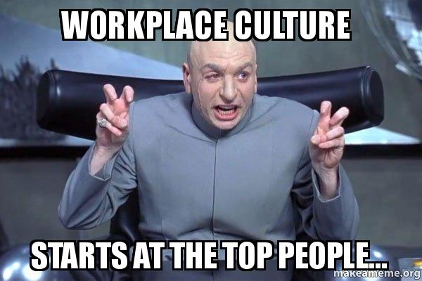
What is culture and why is it important?
“Culture is the work environment that you supply for employees. Employees are motivated and most satisfied when their needs and values are consistent with those manifested in your workplace.”
Source: https://www.thebalancecareers.com/what-makes-up-your-company-culture-1918816

Slide 5
1.
When you’re going down that street
Of running an infosec program

Slide 6

No Easy Days
Information Security is a challenging, often-thankless job. Your success is generally measured by things NOT happening.

Slide 7
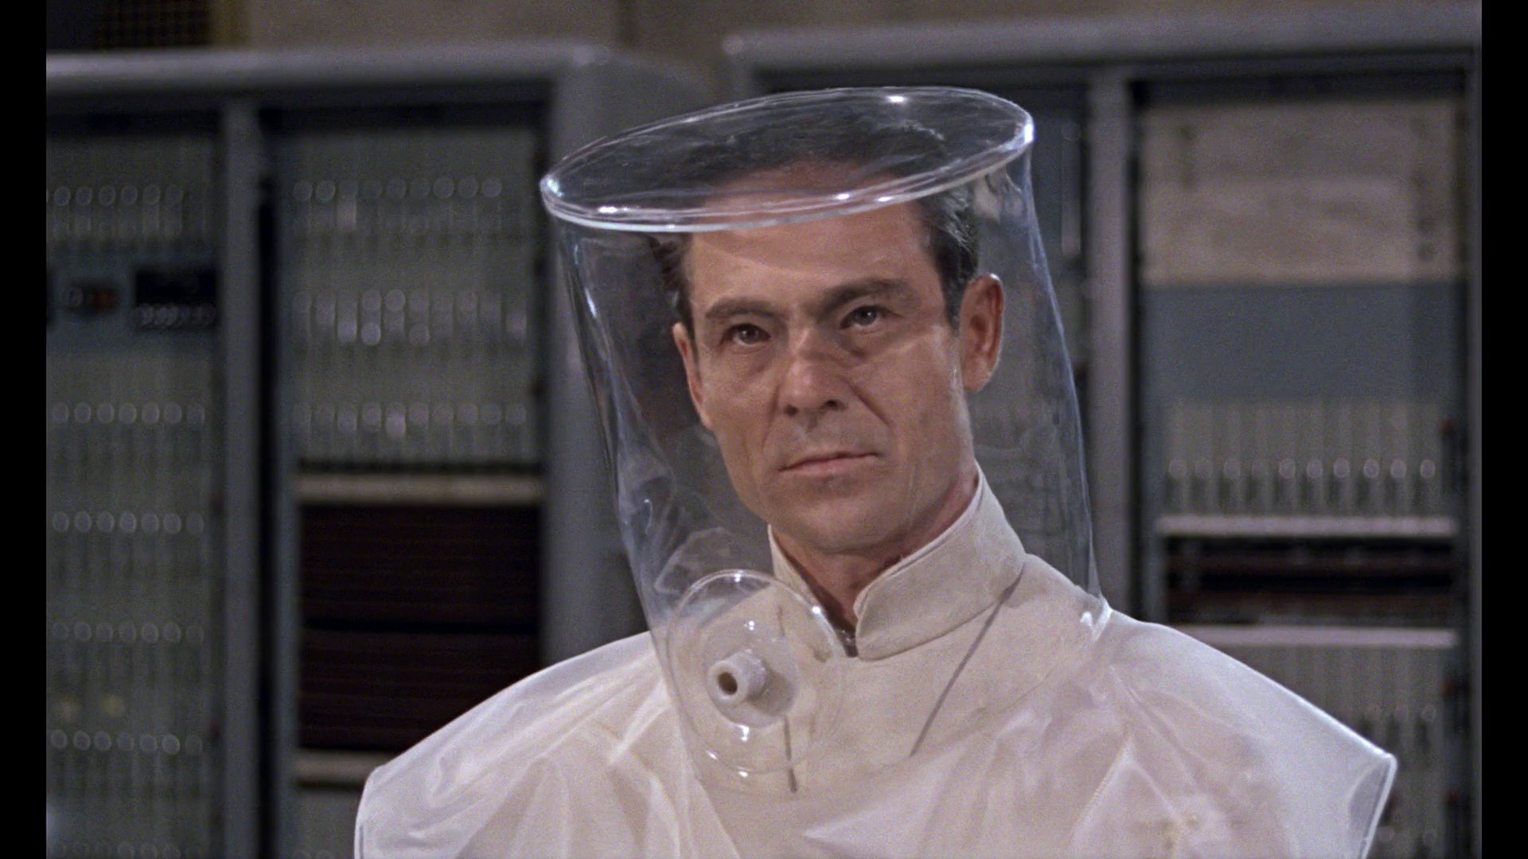
Let’s all avoid being THAT guy
InfoSec has cultivated the reputation of being the “Department of NO!”
This is portrayed in fiction, film, and countless blogs
To be effective in growing your Culture of Security, YOU must lead by example

Slide 8
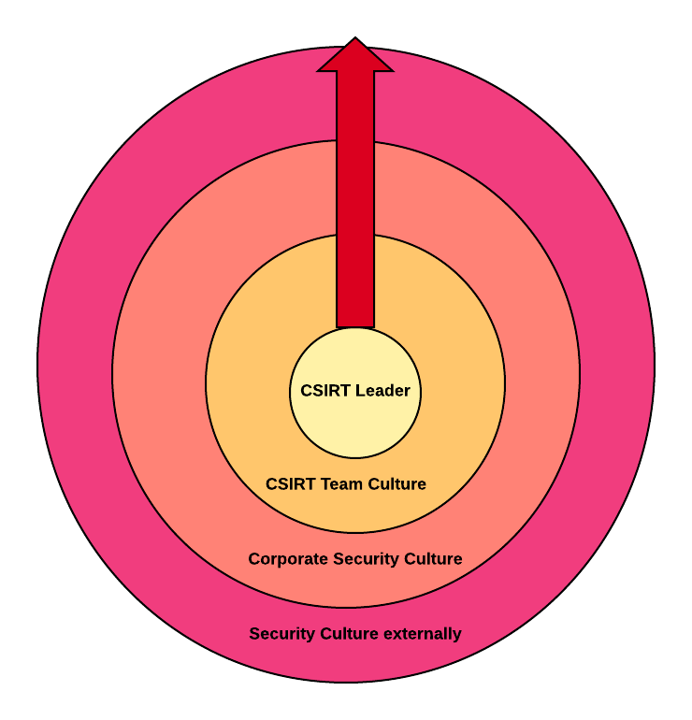
Layers of Culture

Slide 9

Your Shadow
Your attitude and outlook directly affect your team and interactions with all of your customers.
YOU set the tone for everything that follows.

Slide 10
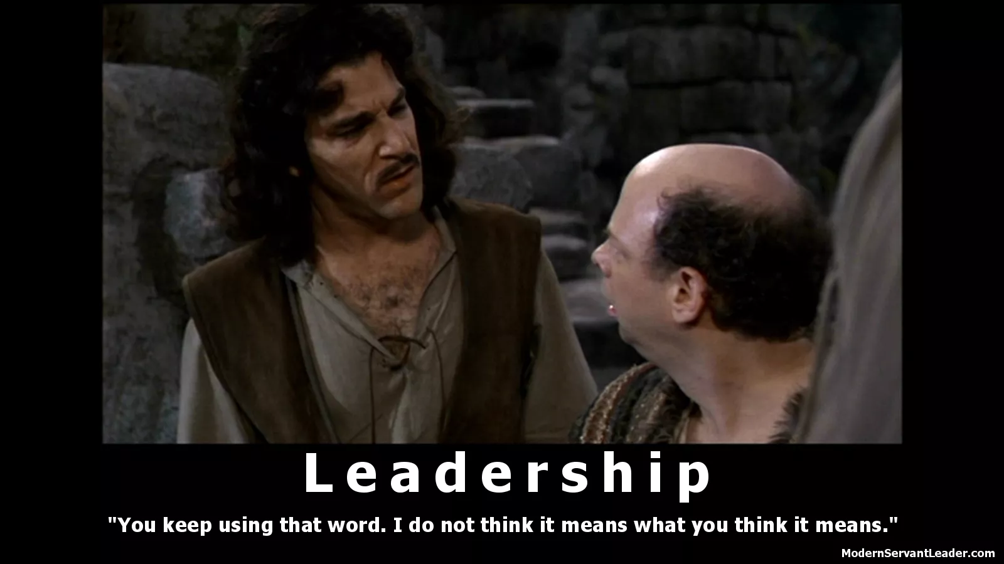
Leadership is not about a title or a designation. It's about impact, influence and inspiration. Impact involves getting results, influence is about spreading the passion you have for your work, and you have to inspire team-mates and customers.
-- Robin S. Sharma

Slide 11
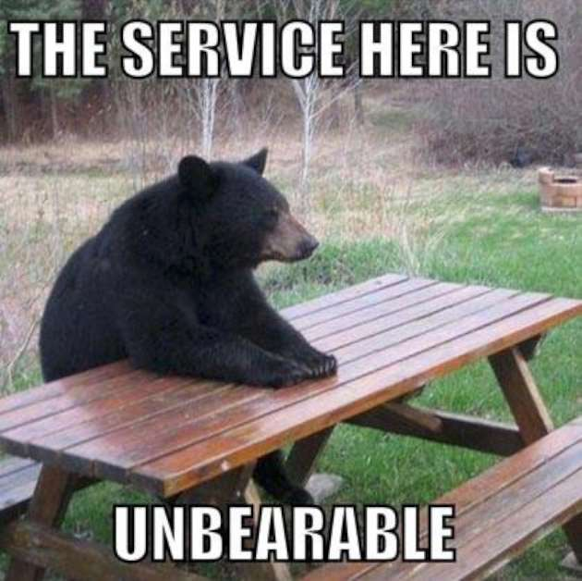
Security as a Service
Transform yourself and your team into a service-focused group. Go out of your way to help teach your stakeholders about your world, listen when they tell you about theirs.

Slide 12
Some Helpful Resources - Leadership
Start with Why - Simon Sinek
Leaders Eat Last - Simon Sinek
The Open Organization - Jim Whitehurst
Servant Leadership: A Journey into the Nature of Legitimate Power and Greatness - Greenleaf & Spears

Slide 13
BIG CONCEPT - Leadership
Positive Security Culture starts with YOU!

Slide 14
2.
Karma Chameleon
Loving would be easy if your colors were like my dreams

Slide 15
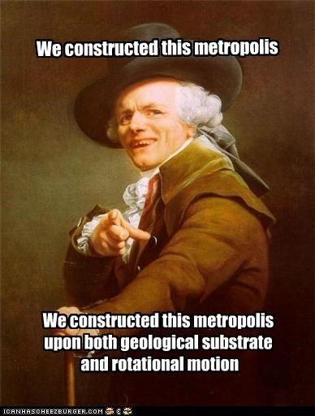
Building a team (on Rock-n-Roll!)
Having Mastered your leadership skills, now it is time to focus on those around you.

Slide 16
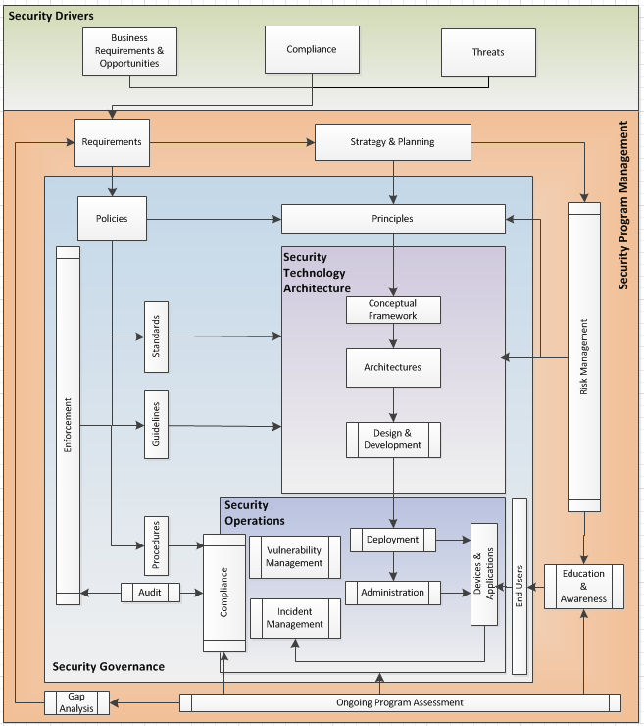
All Models are wrong, some are useful
Based on OESA – Open Enterprise Security Architecture – http://www.opengroup.org/subjectareas/security/architecture

Slide 17
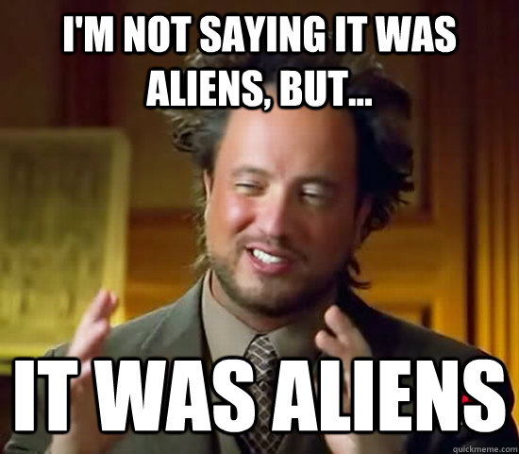
What makes people tick
Those just collecting a check
Those looking to learn
Those looking to gain XP
The True Believers
Team members need to understand why they are participating on the team and how the team fits within their organization.

Slide 18
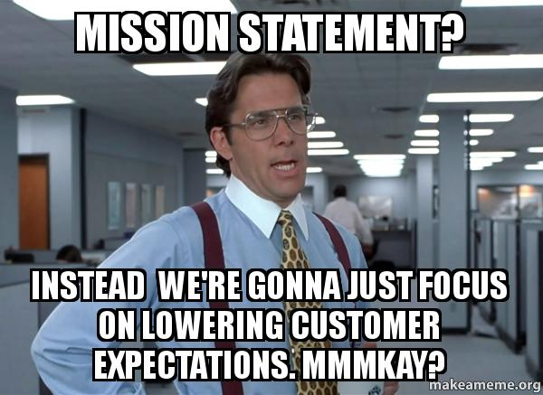
Mission, vision, & goals - more than just words
As leaders, it is our responsibility to set the tone for your organization, leading by example
(remember a few slides ago when I said it was important to do that?)

Slide 19
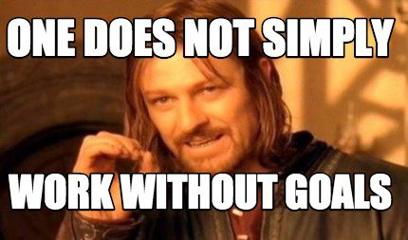
S.M.A.R.T Goals & OKRs
Specific
Measurable
Attainable
Relevant
Time-based
Objectives &
Key
Results
Key
Performance
Indicators
These help associates understand what success looks like

Slide 20
Guiding Principles
Collaboration - Shared problems are solved faster
Transparency - Forces Authenticity and honesty
Accountability - Willingness to take responsibility for one’s actions
Meritocracy - Rewarding the best ideas, no matter where they come from
Participative communities are more open to change

Slide 21
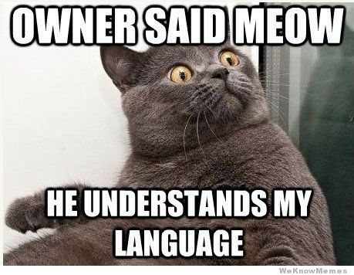
Now you’re speaking my language
Different personality types require different approaches.
Tools Iike DISC or Tilt365 can help you understand your leadership and work styles so you can learn to adjust based off the types you’re interacting with.

Slide 22
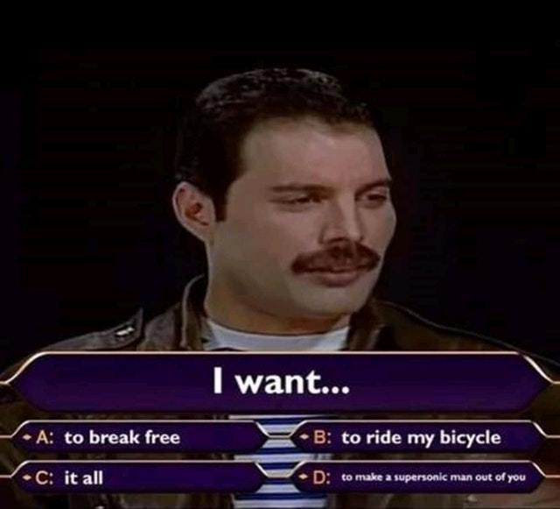
What your employees want, what they really, really want
To be listened to
To know they have an advocate that can remove roadblocks
To have enriching experiences and worthwhile work
To feel like their contributions make a difference

Slide 23

Generating a sense of identity
Cultivating a positive community of professionals that support each other and your customers.
A team identity can help give associates a sense of belonging; forming strong bonds helps reduce attrition.

Slide 24
Some Helpful Resources - Team
The 5 Dysfunctions of a Team - Patrick Lencioni
Death by Meeting - Patrick Lencioni
Slack:Getting Past Burnout, Busywork, and the Myth of Total Efficiency - Tom DeMarco
Writing S.M.A.R.T. Goals - https://www.smartsheet.com/blog/essential-guide-writing-smart-goals
Beginner’s Guide to OKRs - https://felipecastro.com/en/okr/what-is-okr/
Tilt365 - https://www.tilt365.com
DISC Profile - https://www.discprofile.com/

Slide 25
BIG CONCEPT - Team Culture
Establishing a team identity and collaborative culture is KEY to recruiting and retaining associates

Slide 26
3.
Letting Somebody Love You
I walk into the room and light your fuse

Slide 27
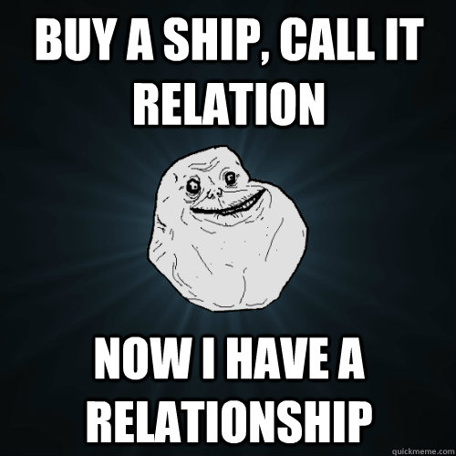
CSIRT’s relation to the rest of the Org
Security can live in many different groups. Knowing where you sit in an org chart can help you understand how to navigate and negotiate your ideas.

Slide 28
ZOMG AWESOMZ CHARTZ!!!
CSIRT
IT Ops
The
Business
Dev

Slide 29
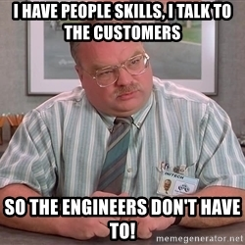
Stakeholder Management
Know your stakeholders and their needs.
Tailor your comms to them.
Understand the key players that can be groomed to be your security deputies.
Cultivate relationships with other Ops teams and Development groups.
Use THEIR language/vocabulary to eliminate ambiguity

Slide 30
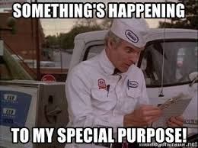
Shared Purpose
Unless you develop and sell security tools…. Security probably ISN’T part of your corporate mission.
Understand the business you work with. What is their jargon? What are their challenges and threats they face.
Steer your team to the same understanding so you focus on tasks/initiatives that help further your organization's goals.

Slide 31
Some Helpful Resources - Organization
FIRST’s CSIRT Services Framework - https://www.first.org/education/service-framework
The Phoenix Project - Kim & Behr
Gung Ho! - Bowles & Blanchard
The Entropy Police: Practicing Information Security in the Enterprise - Guida

Slide 32
BIG CONCEPT - Organizational Culture
The better you understand your organization, the more success you can be in negotiating the implementation of your program

Slide 33
1.
Poisoned Minds
Who am I to say that's crazy? Love will make you blind

Slide 34
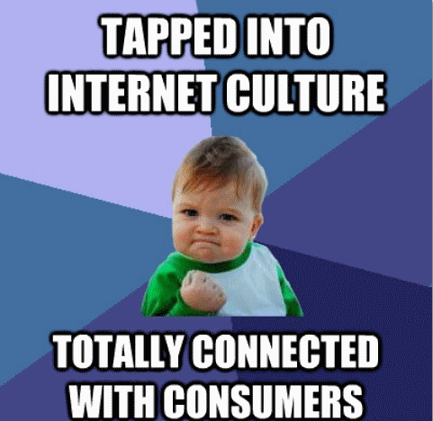
Protecting the Brand
You ARE your brand. Every interaction with customers either strengthens or weakens that brand.
You don’t have to be customer-facing to still have a customer impact.
Ultimately, your processes, policies, and controls are in place to protect your organization and its customers.

Slide 35
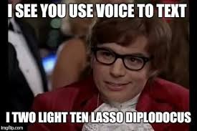
Connecting with Customers
Seek feedback through
Programs like:
Net Promoter Score
Voice of the Customer
Customer Success

Slide 36
Some Helpful Resources - Customers
The Power of Moments: Why Certain Experiences Have Extraordinary Impact - Dan Heath
Customer Success: How Innovative Companies Are Reducing Churn and Growing Recurring Revenue - Steinman, Murphy, & Martinez

Slide 37
BIG CONCEPT - How your culture impacts your customers
The Customer is THE most important part of your business.

Slide 38
Let’s review some concepts
Leading
Model and practice behaviours you want echoed. Influence wins more friends than Authority
Team Culture
Empower your team to succeed. Create an environment that attracts and retains strong talent
Organizational Culture
Cultivate relationships across the company so you understand your stakeholders and so they understand you
Customer-focused Culture
Understand and proactively addressing your customers’ needs

Slide 39



Thanks!
Any questions?
CRob_at_RedHat_dot_com
@RedHatCRob

Slide 40
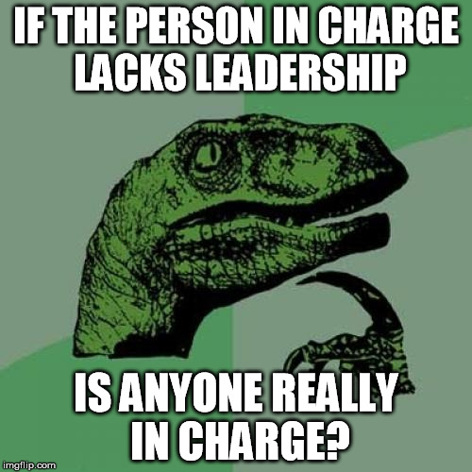
Leading by example
Your team and your partners will look to you, how you conduct yourself, and respond back in kind.
Leaders communicate well, collaborate with peers to achieve shared goals, and have a holistic vision how they fit into the larger organizational structure/mission.

Slide 41

Assembling your Avengers
Want big impact?
Use big image

